Slide 1
MAD Project
IMDB Ratings: The Beta/Binomial model

Slide 2
The Problem
Ratings on IMDB do not follow an obvious distribution.
For example: (next slide)

Slide 3
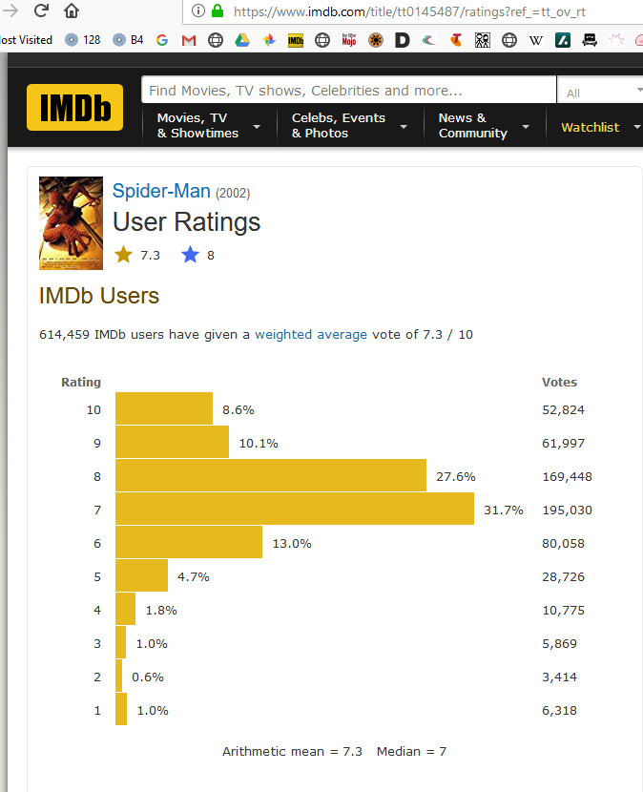
What Ratings Look Like:

Slide 4
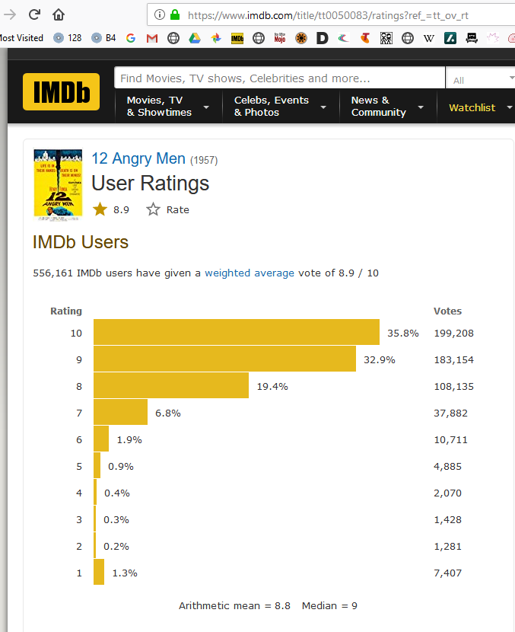
What Ratings Look Like:

Slide 5
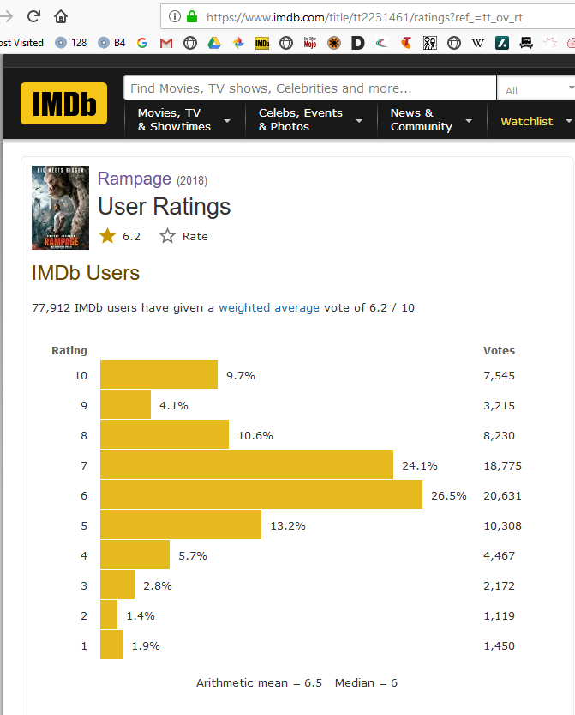
What Ratings Look Like:

Slide 6
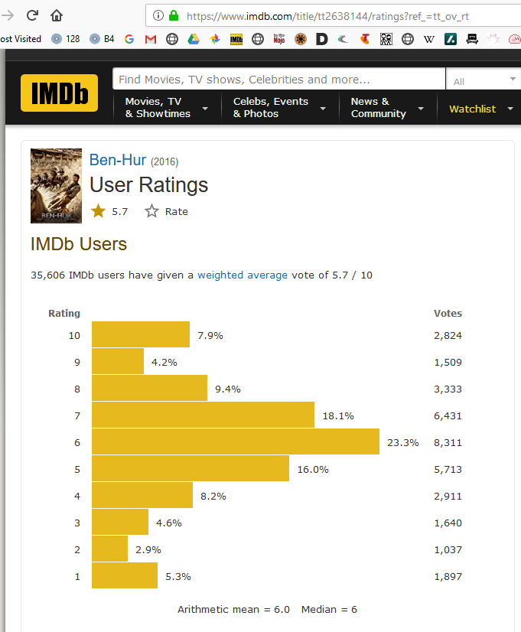
What Ratings Look like

Slide 7
What this looks like:
This looks like a combination of two populations.
One population follows conventional statistical distribution and gives ratings anywhere between 1 and 10.
The other population only gives extreme ratings (1/10, 10/10)

Slide 8
The Beta Binomial model
My solution is to model this as combination of two distributions:
A Beta Distribution for the middle part.
A Binary distribution for the extremes.

Slide 9
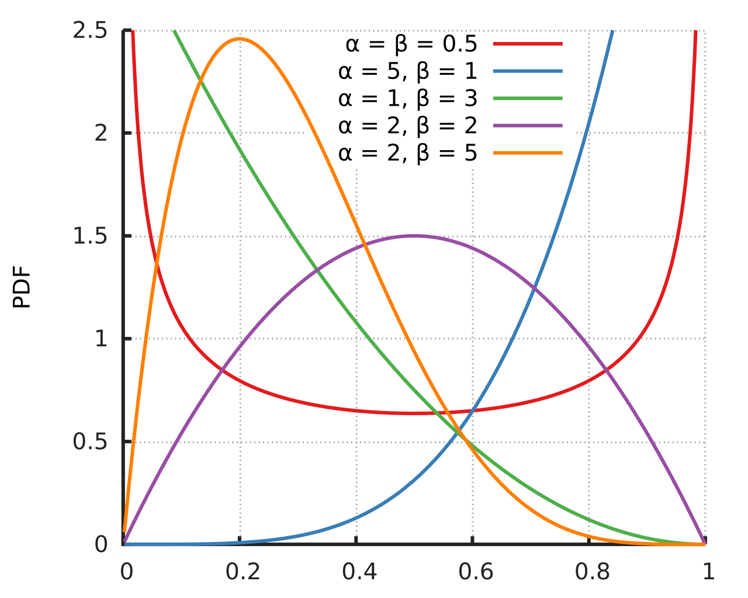
The Beta Distribution https://en.wikipedia.org/wiki/Beta_distribution
Notes:
https://en.wikipedia.org/wiki/Beta_distribution

Slide 10
The Beta Binomial model
Model has four parameters:
a and b for Beta distribution part
polarity: the proportion who are at extremes
binary.ppn: the proportion of 10/10 ratings among the extremes

Slide 11
The Analysis:
Getting the Data
Analysing the Data
Presenting the Results
Publishing the Code

Slide 12
Data Available on IMDB
Data Available from https://datasets.imdbws.com/
title.basics.tsv.gz
Contains information about the movie
title.ratings.tsv.gz
Contains information about number of votes
Notes:
Descriptions of data on https://www.imdb.com/interfaces/

Slide 13

Data Available on IMDB
BUT – ratings.tsv.gz only contains total votes and average rating.
To get number of votes by individual rating had to do web scraping

Slide 14
Programs for Harvesting
Web scraping using rvest package in R.
Scheduling of daily downloads and scraping using taskscheduleR package

Slide 15
The Daily update
Download latest basics and ratings files
Harvest votes for:
New movies with 1000+ votes
Movies with increased votes (+500 or 10%)
Movies which have not bee updated recently
Batch file which runs at 3am, set up using the ScheduleR tool.

Slide 16
Analysing the Data
Fit the model parameters movie by movie
Use R optim function to optimise the parameter values.
Loop through all available movies.

Slide 17
Presenting the data
For each movie variables of interest are:
Mean rating
Median rating
Beta mean (mean of the beta part)
Binary mean (mean of the extreme votes)
Polarity (proportion which are extreme)

Slide 18
Presenting in a dashboard
(demo)
Notes:
Things to cover:
The movie page.
Selection of x variable, y variable, colour variable, log/linear
Filtering by year, by genre(s), media type
Filter by year, # votes, polarity
Tooltip, brushed selection.
The single movie page
Latest results
Votes with means
Beta model, Binary model, Residuals
Table of latest votes
Full results:
Number of votes over time
Means over time
Table of results over time

Slide 19
Publishing the code
Code has been saved to Github
Created personal account so I could more easily work at home
Involved setting up on several computers

Slide 20
Publishing the app
Published to the web using Shinyapps hosting

Slide 21
What I have Learned
How to Harvest from the web (rvest library)
How to schedule a job (scheduleR Shiny add in)
How to fit a model (optim function)
How to present results
Shiny
ggplot
How to set up GIT on a home computer
How to load project on external server

Slide 22
Further work
Fixing the model (residuals are not right)
Movie selection – drill down from movie list
Polarity analysis – Data mining to determine what features of a movie affect degree of polarity?
Movie report – use R Markup to create an automated summary document for a given movie with stats, plots.
Extra information – allow filtering by actor, director etc. title.crew.tsv.gz and title.principals.tsv.gz

Slide 23
Links:
GIT Repository:
https://github.com/BarryHaworth/IMDB
Shiny Dashboard
https://statisticus.shinyapps.io/IMDB/
IMDB Data links

